Slide 2
WHY DO WE HAVE ADVERTS?

Slide 5
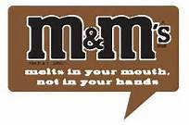
Effective adverts use positive words (a hook) that stand out and give the reader a good feeling about the product. They ignore any negatives.

Slide 8
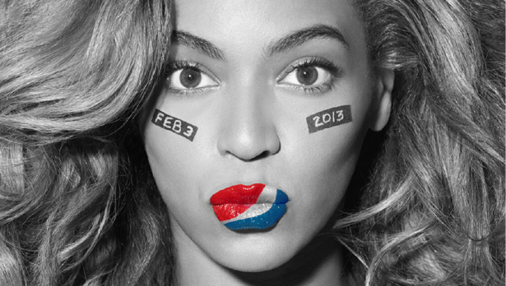
What product is being advertised here and by who?

Slide 9
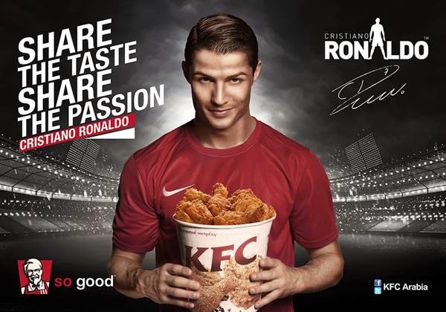
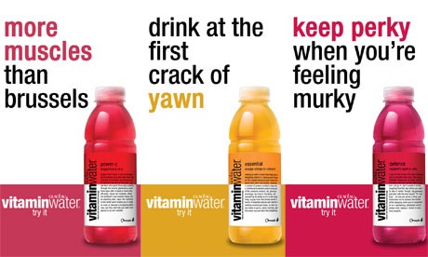
Many effect adverts contain promises
(a hook) that make you feel like
you can’t live without the product

Slide 10
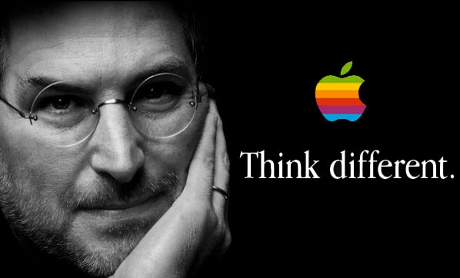
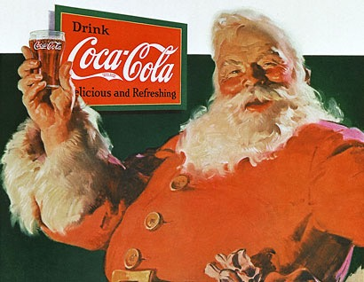
Effective adverts generally have
eye catching and memorable pictures
(a hook)

Slide 12
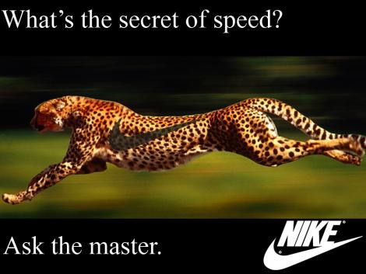
Effective adverts often use rhetorical questions. What is a rhetorical question? A rhetorical question is used for effect. It does not need to be answered.

Slide 15
Take a minute to think
about a BOSSY verb in a sentence
to advertise for a theme park.

Slide 18
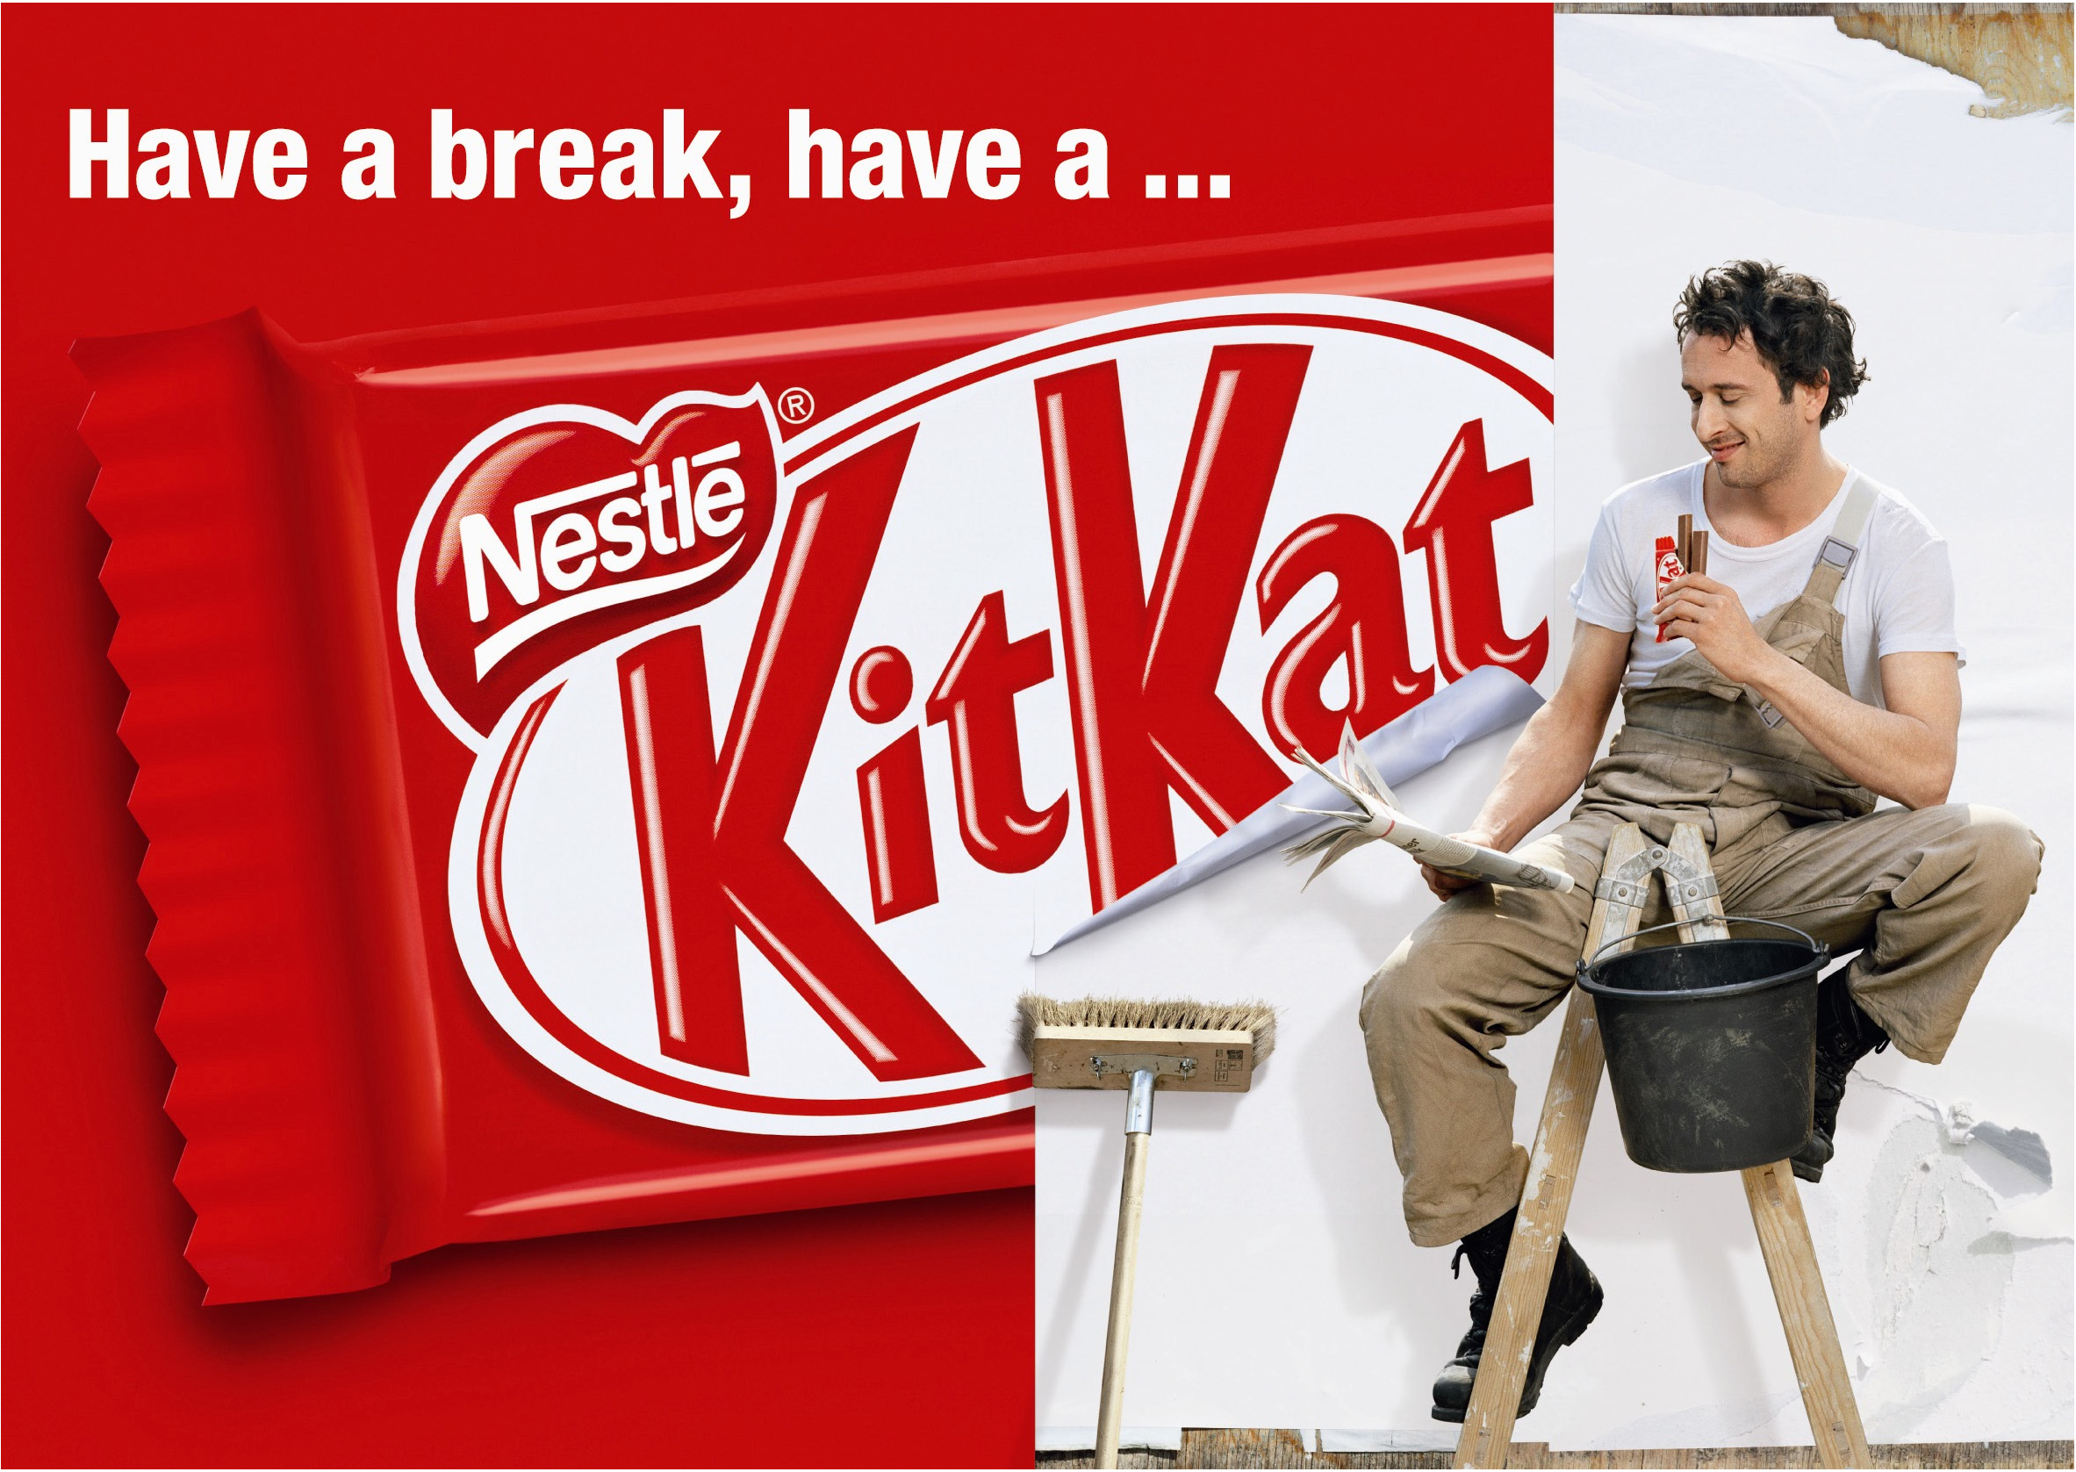

Slide 20
Lets take a look at some commercials.
https://www.youtube.com/watch?v=uw08j-yOfcE
https://www.youtube.com/watch?v=l8-Mr1Vf2iw
https://youtu.be/yjjb_Dy7tXg?list=PL5F-BsyODxxcU9c8fnTn2JlX-d050xztH

