Slide 1
Antonyms, Synonyms & Homophones

Slide 2
Learning Outcomes
Give an example of an Antonym, Synonym and Homophone
Answers questions on the Antonym, Synonym and Homophone Kahoot Quiz
Get Partner to Jumble Words
Re-sort your words
Flash Cards – Spelling City
Vocab Test Me – Spelling City

Slide 3
AntonymS
Definition
An antonym is a word that has an opposite meaning of another word
Example Loud / Quiet

Slide 4
synonyms
Definition
A synonym is a word that has nearly the same meaning as another word
Modern = New

Slide 5
HOMOPHONEs
Definition
A homophone is a word that is pronounced the same as another word but has a different meaning
Bread or Bred

Slide 6
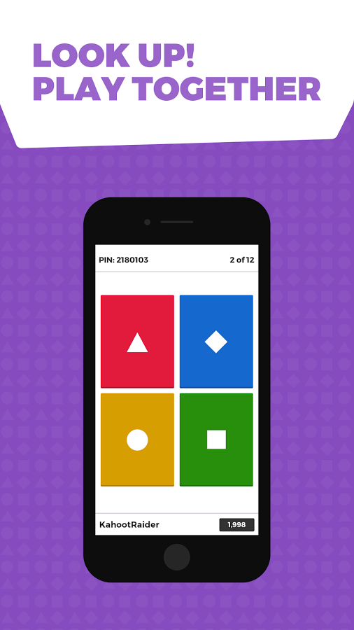
Kahoot
Interactive Quiz for Whole Class
Questions on the interactive whiteboard
Each student logs in on Macbook - https://kahoot.it/
Enter the pin code for the quiz
Answer the questions with the colour coded symbols on your macbook.
Questions are timed so be quick – more points for speed but need to be accurate
Top 5 will be displayed at the end.
Who will be the winner?

