Slide 1
Conjunctions

Slide 2
Learning Outcomes
Conjunctions Song
Graffiti Wall of Conjunctions
Group Activity – Conjunctions – Create Meaningful Sentences
Spelling City
2 groups to work with Mr Beaman and Mrs Spencer
Spelling List extensions – new words with same pattern and adding suffixes to existing words.

Slide 3
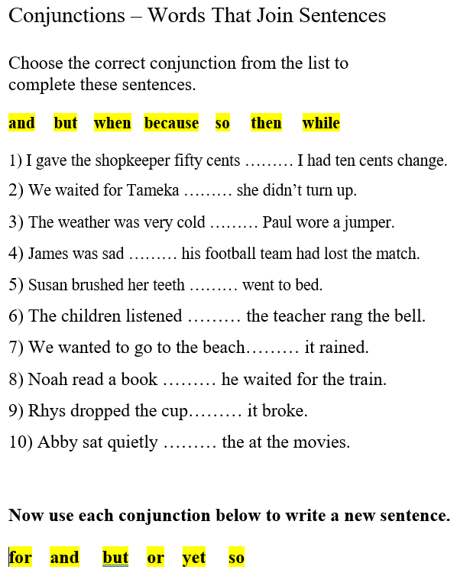

Slide 5
